Slide 1
Spring Fundamentals

Slide 2
What is Spring?
Spring is an open-source Java framework, and a collection of libraries that solve common enterprise development tasks
Spring is primarily used for web server and service development, but it’s flexible and can be used in almost any project

Slide 3
Frameworks vs Libraries
Frameworks
Libraries
A framework is shared code that calls your code according to some pre-determined structure
With a framework, your code’s structure must match the framework’s intended use
A framework can be thought of as a mini, specialized runtime for your code
A library is shared code you can call from your code
With a library, you’re free to structure the code surrounding library calls however you like
A library can be thought of as a collection of utility code

Slide 4
Inversion of Control (IoC)
Inversion of Control is a software design pattern
The control that is being inverted is the developer’s control over how their code is executed
With an IoC framework, we define classes and methods, but we don’t decide when they’re instantiated or used – that’s the framework’s job!

Slide 5
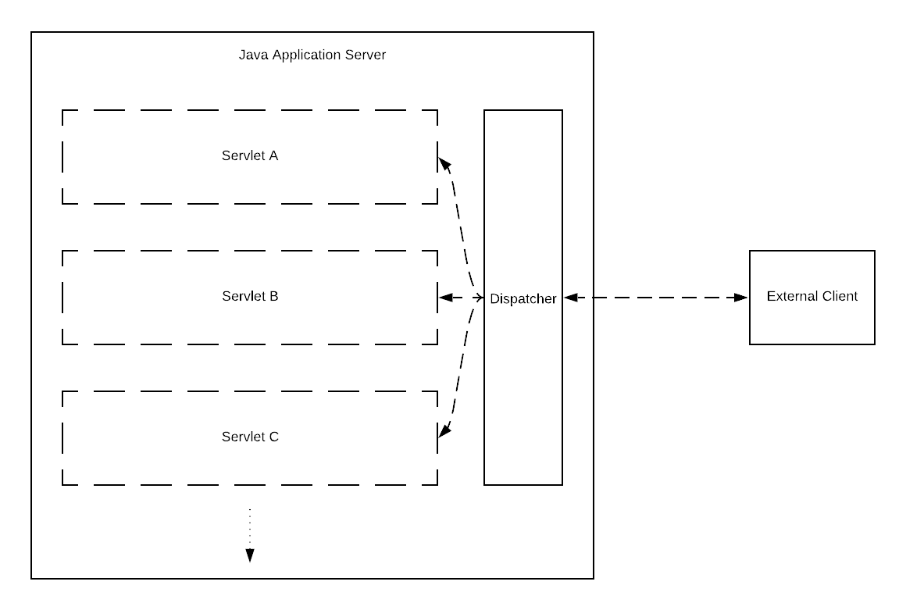
Example: Java Application Servers and Servlets

Slide 6

Servlets and Lifecycles
A servlet is an interface defined by the Java: Enterprise edition
By implementing the interface, you’re creating a class that the Java App Server can instantiate and manage
The interface defines three methods you can implement to allow the App Server access to your program: init(), service(), and destroy()
These “lifecycle methods” allow the App Server to hook into our code and trigger events that our code should respond to
That’s Inversion of Control!

Slide 7
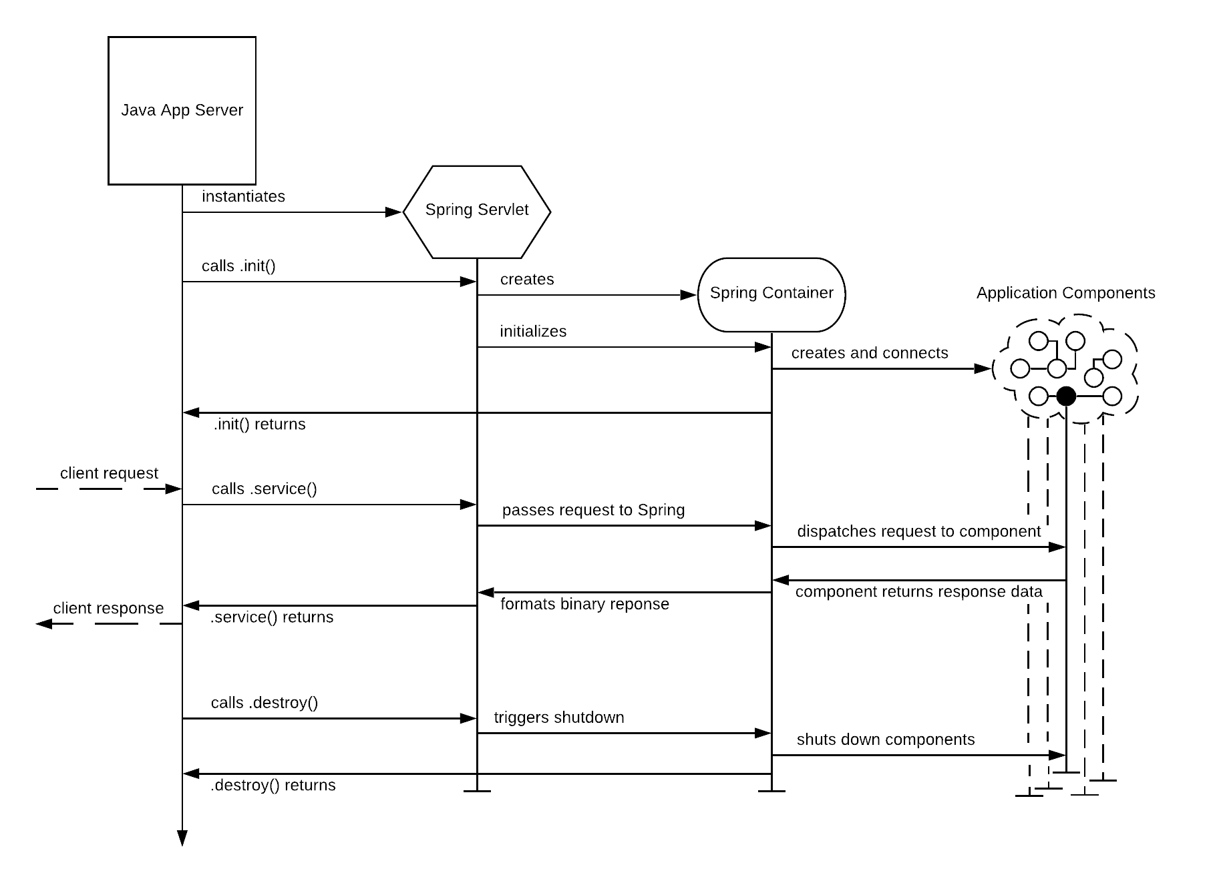
Springs Lifecycle

Slide 8
Components and Dependency Injection
Spring Implements Inversion of Control through dependency injection
When we build a Spring application, we do so by defining the components needed and how they depend on each other
When our app runs, Spring finds the components we defined and creates them, injecting any dependencies between them as needed

Slide 9
Architecting a Spring Web Service

